Slide 1
Contact-Free Heart and Respiration Rate Measurement
System Based on Real-Time Human Face Video
Eugene Dobryakov - Team Leader
Quan Nguyen
Roman Melnik
Faculty Advisor - Dr. Essa
Team / Project - 115

Slide 2
Outline
Executive Summary
Background and Problem Statement
Objective
Technical Approach
Experimental Results
Deliverables
Project Timeline/Gantt Chart
Budget
Professional Awareness
Conclusion

Slide 3
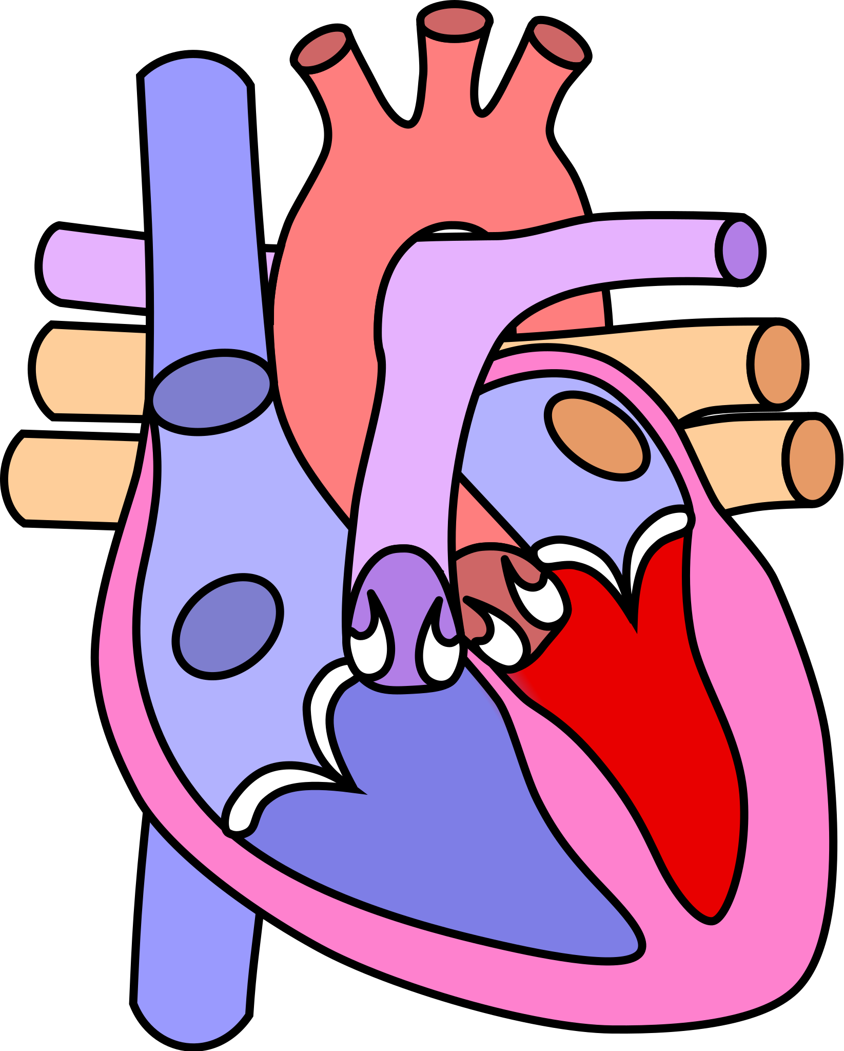


Executive Summary
The heart is at the center, and the most important organ of the
circulatory system.
Elevated heart rate and respiration rate are physiological signs
associated with COVID-19.
It can take just one individual infected with COVID-19 to spread
the virus to at least two additional people _{[1]}.
Heart rate (HR) and respiration rate (RR) can be measured in
real-time through video without ever coming in contact with
another individual.

Slide 4
Background - Did You Know..
50%
4 in 10
3.2 fold
Survey participants stated they would delay medical care during COVID-19 pandemic without access to telehealth services.
U.S. adults avoid medical care due to concerns regarding COVID-19.
Increase in mortality rate for COVID-19 patients whose respiratory rate exceeds 22 breaths per minute.
COVID-19 Healthcare Coalition
https://c19hcc.org/telehealth/patient-survey- analysis/
Delay or Avoidance of Medical Care Because of COVID-19–Related Concerns
http://dx.doi.org/10.15585/mmwr.mm6936a4
Admission Respiratory Status Predicts Mortality in COVID 19
https://onlinelibrary.wiley.com/doi/10.1111/irv.12869

Slide 5
Problem Statement
Measuring HR
Clinical Standard - ECG _{[2]}
Leading Method For Individuals - Manually Checking Pulse _{[3]}
On The Rise - Wearables Such as Fitness Trackers
Challenges
ECG - Factors such as pregnancy and obesity interfere with results _{[2]}
Manually Checking Pulse - Not Accurate
Wearables - Measures blood flow when its farthest away from the heart
Opportunity
Re-evaluate delivery of health care during and subsequent of the pandemic
Lift and shift system to measure HR and RR in real-time through video

Slide 6
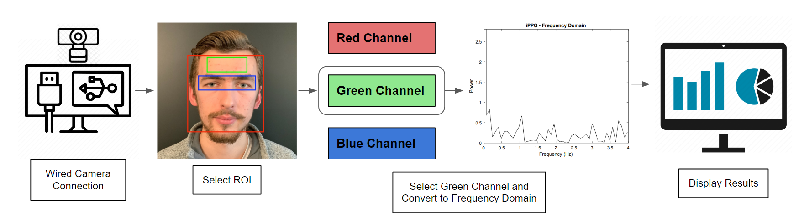
Objectives
1
2
3
4
Extract region of interest (ROI) with an RGB-D camera
Extract the raw RGB signals from the ROI
Convert signals to a frequency domain to obtain HR and RR
Display HR and RR to the subject

Slide 7
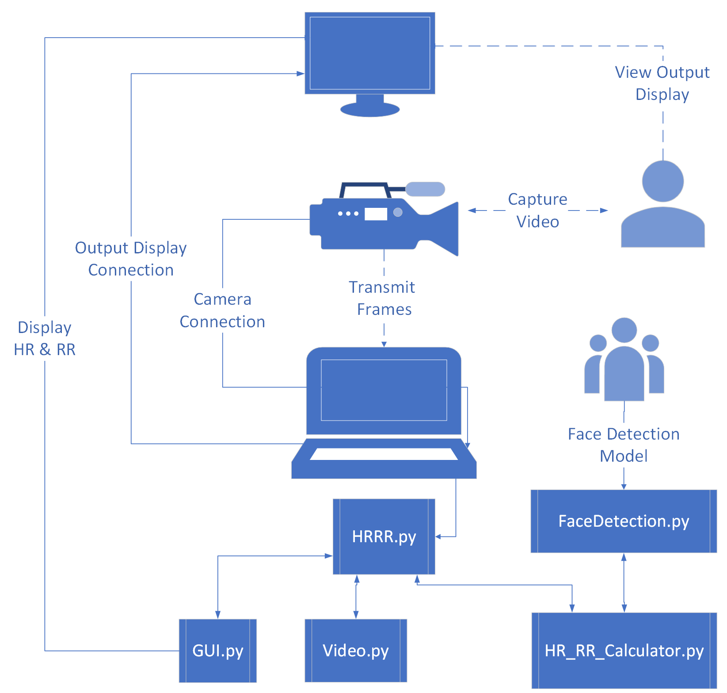
Technical Approach
Software Architecture Overview

Slide 8
Feeding Live Video Into the Program
In real time -> live video input
High frame per second to compensate for processing time
Wired connection
Improved security

Slide 9
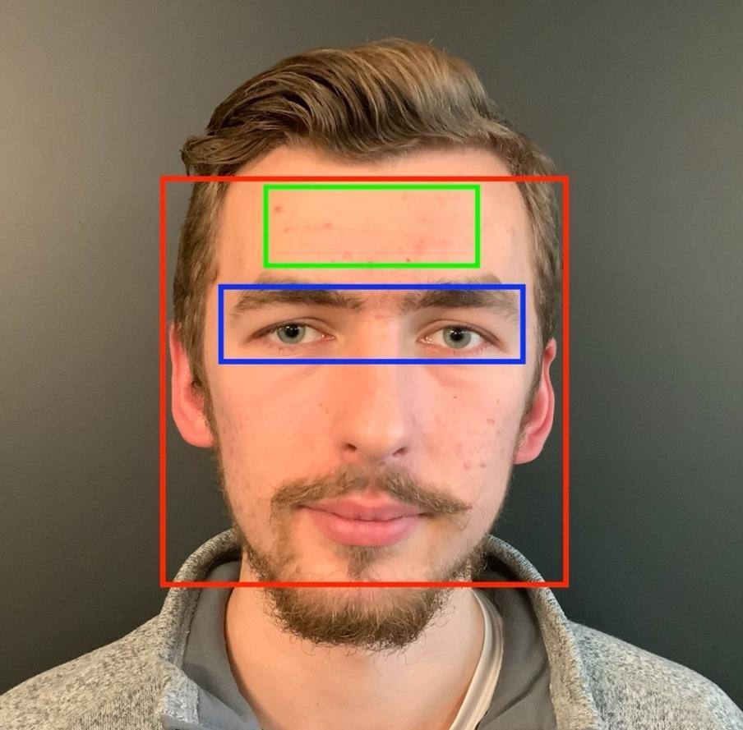
Selectin the ROI
Why the forehead?
Good accessibility
Minimum computing area
Not covered by clothes or accessories
Proved to be efficient in previous studies _{[5]}

Slide 10
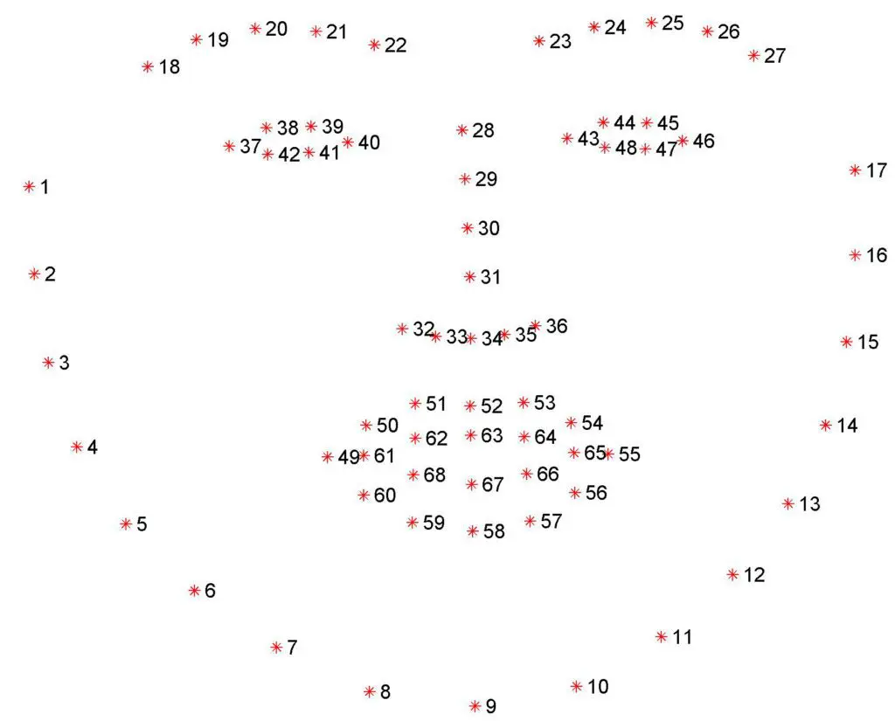
Detecting the Forehead
Pretrained AI model using CMake and Dlib libraries
Model detects 68 facial landmarks
Need 4 landmarks: 20, 25, 38 and 44
Mirror 38 and 44 across 20 and 25
Convert input frames to grayscale to process
68 Facial Landmarks

Slide 11
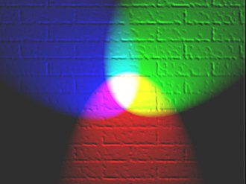
Using the Green Channel
Easier for the skin to absorb the green color
High signal-to-noise ratio _{[6]}
Better reading => more precise output
https://en.wikipedia.org/wiki/RGB_color_model

Slide 12
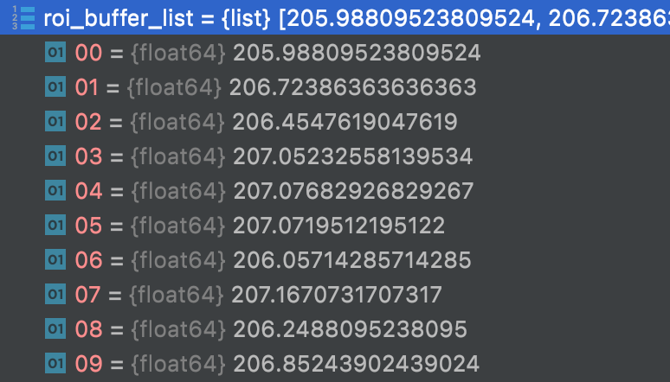
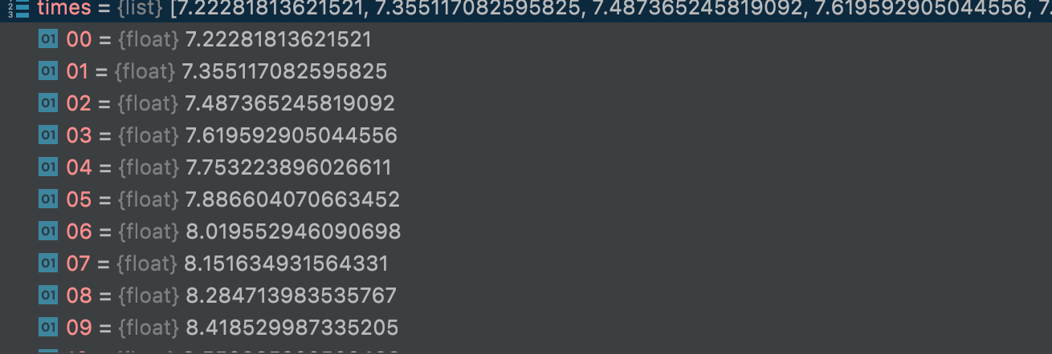
Extracting Raw Signal
Store data in time domain: Extract signals of ROI from input frames, calculate mean ROI Value for the first several seconds and store in a buffer.
The program matches the mean ROI value with the corresponding time.
For best FFT function results, size of time domain should be a value of 2^{n}, where n is the number of sample points (i.e., frames)
Mean ROI value for each frame
Corresponding time for each Mean ROI value

Slide 13
Conversion Process
2^{n} frames captured over time period Δt
Frame 0 at t₀, frame 2^{n-1} at t₋₁
Create an evenly spaced time period list (ESTPL)
Example: 64 frames captured at 8fps, means ESTPL is [0.000, 0.125, 0.250, …, 7.875]
Detrend values to remove linear trend
Generate a list of incrementing frequencies via NumPy Function
[0.122890625, 0.24578125, …] (later multiply by 60)
2^{n} frames makes a 2^{n} list of frequency values
[7.3734375, 14.746875, …]
This is the first sign of the HR

Slide 14
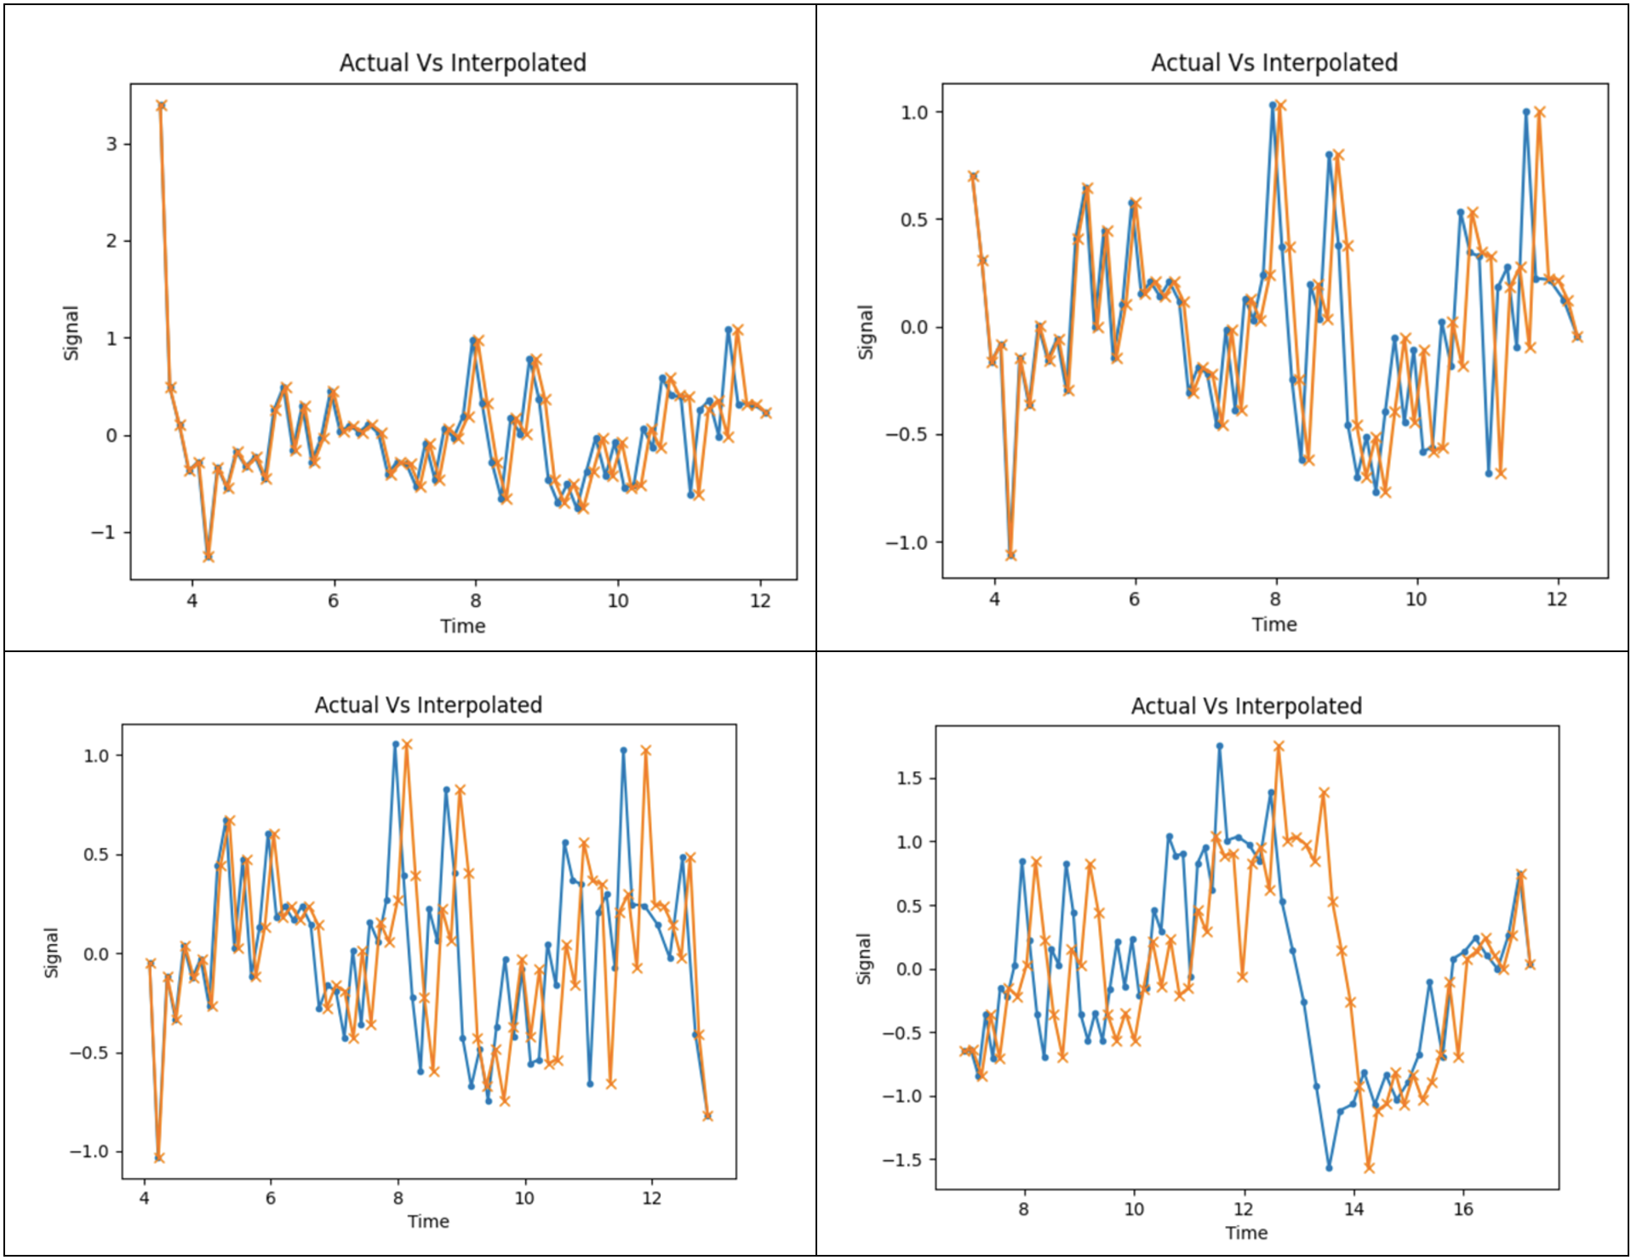
Conversion Process
We use interpolation to estimate unknown values (requires ESTPL)
Allows us to say this is where the data point would have been had it occurred at the time in question
Interpolated data is normalized before being converted to Frequency Domain.
Interpolation - About ~16 Seconds

Slide 15
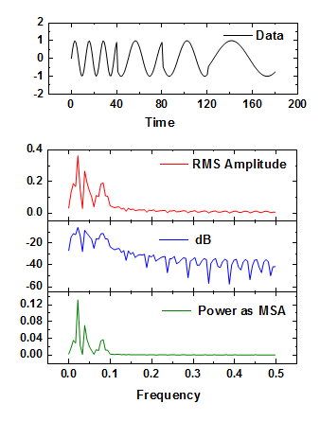
Analyzing the Signals
Transform signals from time domain to frequency domain using Fast Fourier Transform (RFFT)
HR: 0.8 to 2.2 Hertz _{[7]} & RR: 0.18 to 0.5 Hertz _{[7]}
Identify the signal peak and look at the same “frequency” bucket.
If peak in index 8, then the corresponding values for the HR or RR is in the 8th index of the frequency list.
Display the result

Slide 16
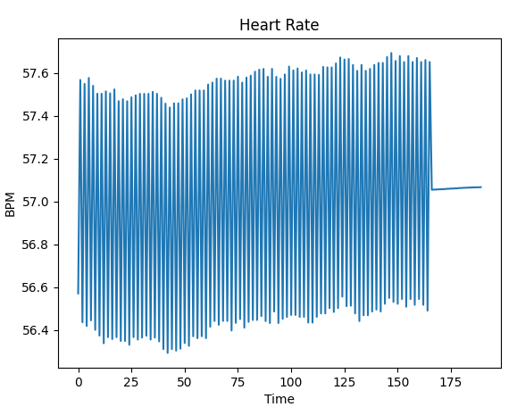
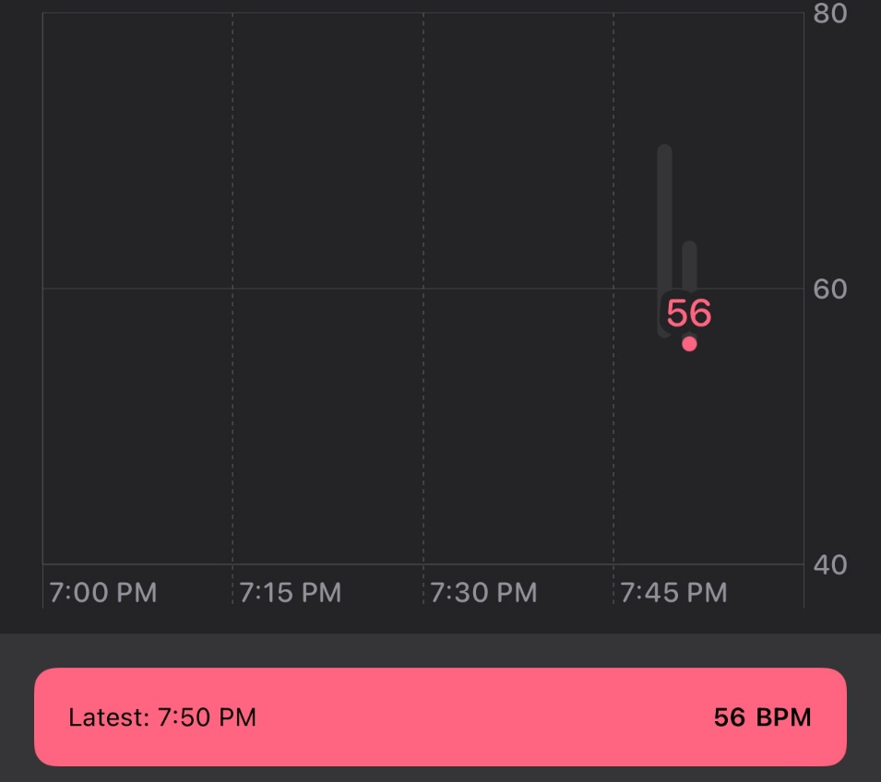
Experimental Results - HR
HR data validation with Apple Watch HR Monitor application
HR Testing Results
Apple Watch HR Monitor

Slide 17
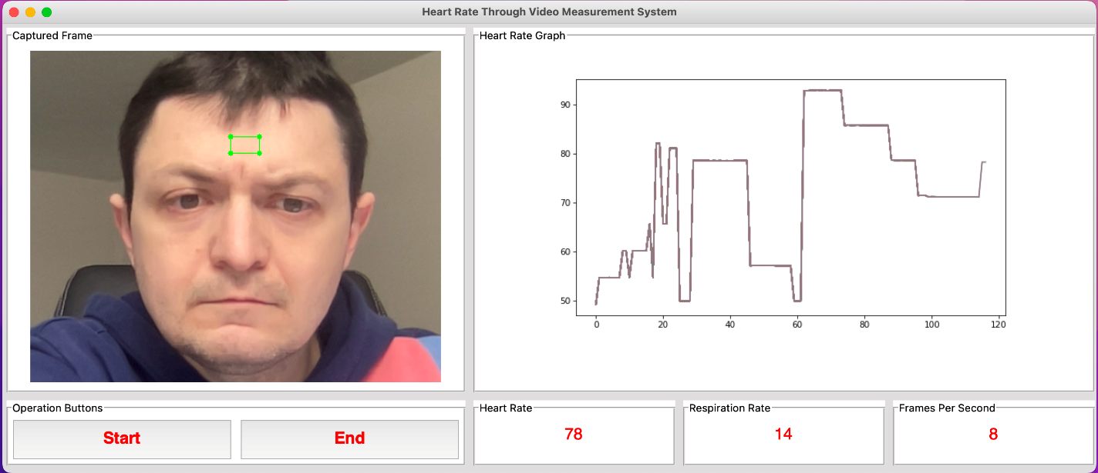
Experimental Results - RR
RR data validation - physical count of number of breathes in a 20 second time period
Multiplied by 3 to obtain number of breathes per minute
5 breathes recorded during the 20 second window in this test
5 * 3 = 15 breathes per minute
Program detected RR to be 14 breathes per minute

Slide 18
Deliverables
Portable, lift-and-shift system
Contact-free and real-time system
Compatible on common OS (Windows, MacOS)

Slide 19
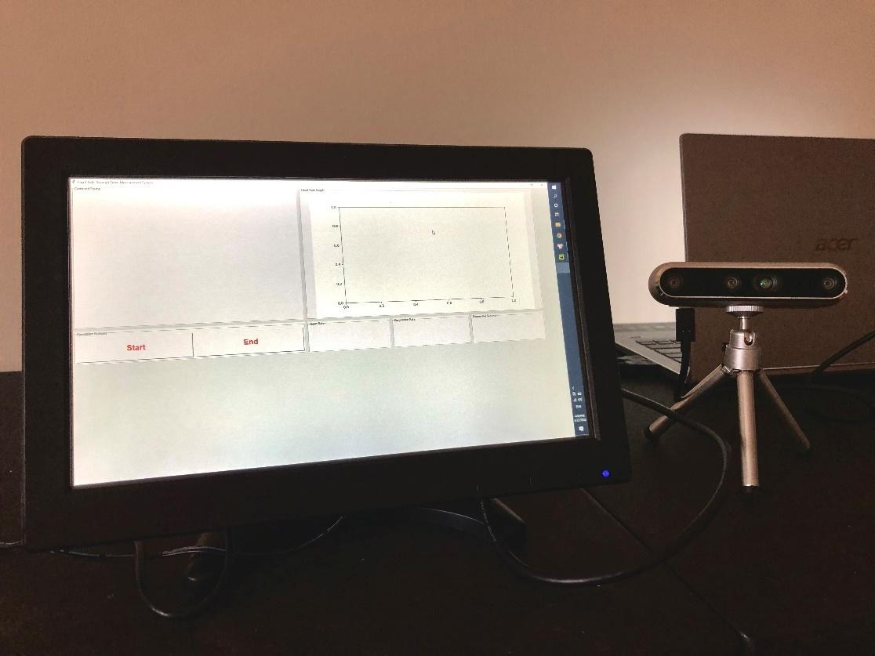
Deliverables
Final Product with Touchscreen Monitor and Camera

Slide 20
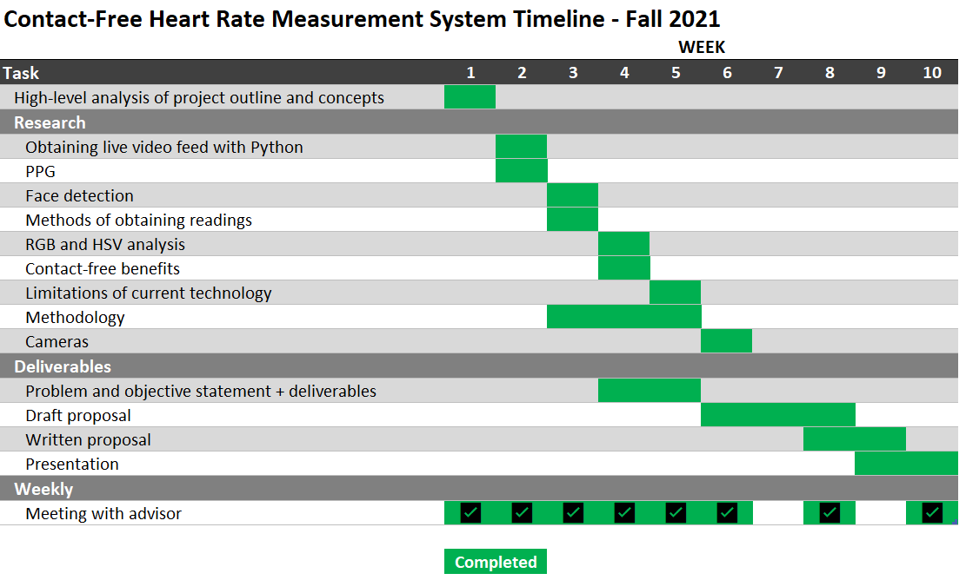
Project Timeline/Gantt Chart - Fall 2021

Slide 21
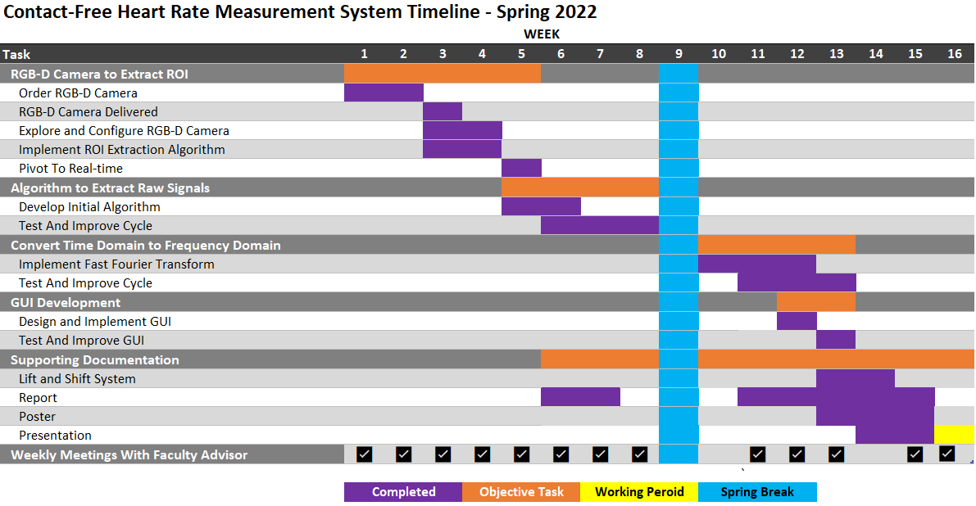
Project Timeline/Gantt Chart - Spring 2022

Slide 22
Budget
Item | Supplier | Quantity | Unit Price | Total
Intel RealSense Depth Camera D455 | Intel | 1 | $433.94 | $468.88
12 Inch Touchscreen Monitor HDMI 1920x1080 FHD IPS Screen | TOGUARDGO | 1 | $129.99 | $140.39
 |  |  | Total: | $609.27

Slide 23
Professional Awareness
Important that data from the ROI be kept private
Evolving technology provides room for future advancements
Contributes to well-being of society as a tool against COVID

Slide 24
Conclusion
Contact-free, real-time HR and RR measurement system with multiple benefits
Positively impacts telehealth assessments.
Helps to detect elevated heart rate and respiratory rate.
Advances the delivery of medical service during and subsequent of the pandemic.
System can be moved from point to point with minimal effort.

Slide 25
Questions

Slide 26
References
[1] Nazario, Brunilda. “How Coronavirus Is Transmitted: Here Are All the Ways It Can Spread.” WebMD, WebMD, 18 Aug. 2021, https://www.webmd.com/lung/coronavirus-transmission-overview#1
[2] “Electrocardiogram.” Johns Hopkins Medicine, https://www.hopkinsmedicine.org/health/treatment-tests-and-therapies/electrocardiogram
[3] “Want to Check Your Heart Rate? Here's How.” Harvard Health, 17 Aug. 2021, https://www.health.harvard.edu/heart-health/want-to-check-your-heart-rate-heres-how
[4] Team, Heart and Vascular. “Your Fitness Tracker Isn’t the Best Way to Measure Heart Rate.” Cleveland Clinic, Cleveland Clinic, 18 May 2020, https://health.clevelandclinic.org/your-fitness-tracker-isnt-the-best-way-to-measure-heart-rate/
[5] S. Kwon, J. Kim, D. Lee and K. Park, "ROI analysis for remote photoplethysmography on facial video," 2015 37th Annual International Conference of the IEEE Engineering in Medicine and Biology Society (EMBC), 2015, pp. 4938-4941, doi: 10.1109/EMBC.2015.7319499.
[6] Y. Lin and Y. Lin, "A study of color illumination effect on the SNR of rPPG signals," 2017 39th Annual International Conference of the IEEE Engineering in Medicine and Biology Society (EMBC), 2017, pp. 4301-4304, doi:10.1109/EMBC.2017.8037807.
[7] Shourjya Sanyal and Koushik Kumar Nundy, “Algorithms for monitoring heart rate and respiratory rate from the video of a user’s face,” IEEE Journal of translational engineering in health and medicine, vol. 6, pp. 1–11, 2018. https://www.rouast.com/pdf/rouast2016remote_a.pdf

